Slide 1


Gemino: Practical and Robust Neural Compression for Video Conferencing
Vibhaalakshmi Sivaraman, Pantea Karimi, Vedantha Venkatapathy, Mehrdad Khani, Sadjad Fouladi,
Mohammad Alizadeh, Frédo Durand, Vivienne Sze
Notes:
Replace with pictures

Slide 2


Traditional Video Conferencing
Sender
Receiver
Video Encoder
Video Decoder
Target
Encoded Video
Decoded Video
target bitrate
Notes:
Frames are read off the camera at the sender, put through a video encoder which produces packets for the wire
The packets are sent to the receiver which decodes them and displays them.
The amount of data sent is affected by the extent of compression which is controlled by continuous target bitrate feedback from the sender to receiver. Smaller the target bitrate, less data is sent over and the more distorted the received video is.

Slide 3
How much can you compress?
1024x1024 resolution
30 frames per second
Lower is Better
Notes:
To see how well this works in practice, we supply a time varying target bitrate from 1 Mbps to 20 to vp8 and measure the LPIPS, a learned similarity metric, for the decoded video in the bottom graph
Distance based metrics -> lower is better
1024x1024 video frames at 30 fps

Slide 4
How much can you compress?
1024x1024 resolution
30 frames per second
Cannot go below ~ 550 Kbps
Lower is Better
Video conf. apps recommend 2-3 Mbps minimum
Notes:
VP8 responds to the target bitrate initially with degrading quality as it compresses more, but it saturates at 550 Kbps.
Nothing salient about this number: it’s a particular video and codec, but is because these codecs are constrained in how much they can optimize in real-time settings.

Slide 5

Global Bandwidth Map
Notes:
This is broadband, wifi/cellular is a different story
Fcc definition of reliable internet speeds is around 25 Mbps
Parts of Africa have less than 2 mbps
Reducing bandwidth means enabling video conferencing in such locations that cannot currently access it
Few 100 million people of this world – cannot actually have reliable internet connections
Parts of Africa, and asia – do not have high enough broadband connection – cannot sustain more than a few mbps. For example, parts of Africa and
countries that have really poor broadband also have lower-end devices. We've thought about efficiency at the architecture level, not at an implementation level. In a few years, the tech will get there, we can equip people with phones. Upgrading the bandwidth is a lot harder to do for an entire country. Hardware that enables video codecs that are optimized already in edge devices, we haven't been able to leverage it

Slide 6
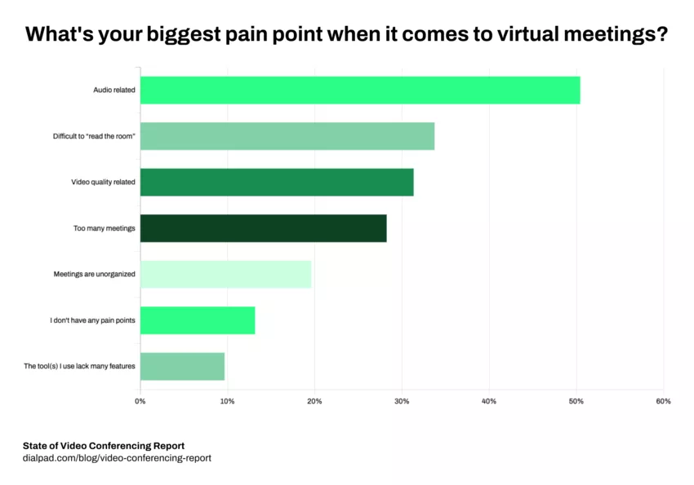
Poor User Experience
Disruptions are caused by “tail” events
E.g., 1 sec. of network congestion every few min.
Hard to solve by adding capacity
Notes:
Disruptions are not determined by average bandwidth, but rather by tail very infrequent bad scenarios. Not gonna go away, there will always be a tail, standards are likely to go up. Today, we’re using 720p. Likely to go up. 1080p, expectations around video quality will go up.
LONGER DISTANCE CALLS – many many things can go wrong
All too used to sudden drops in video quality where there’s a transient pixelated video
Or a frame with a glitch
Or some version of “can you hear me”, “can you see me now”
Most of these happen not because network bandwidth is fundamentally low, but because it goes through some time-varying nature, where it may drop briefly before picking back up

Slide 7
Can we dramatically reduce video conferencing bandwidth requirements?
Notes:
let me show you one quick example of achieving video conferencing at audio like bitrates.
talk abouut downsampling along with bitrate vein

Slide 8

Gemino’s Neural Video Conferencing
Replace traditional signal processing with predictive modelling
Receiver
Sender
Reference
Down-sampler
Video Encoder
Neural Decoder
Low-res
target
Target
Encoded
Video
Reconstruction
Notes:
Talk about original and decoded not being identical
different extents of compression have different amounts of loss/quality degradation around it
common examples: vp8/vp9/av1
codecs have been around for a while, whats actual compression
use packets -- instead of encoded video

Slide 9
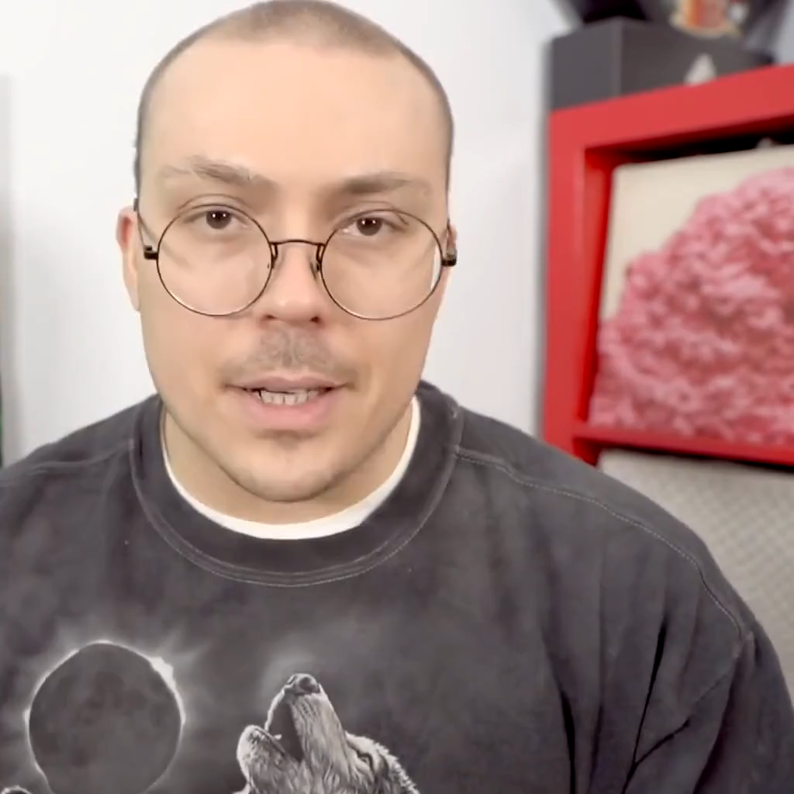
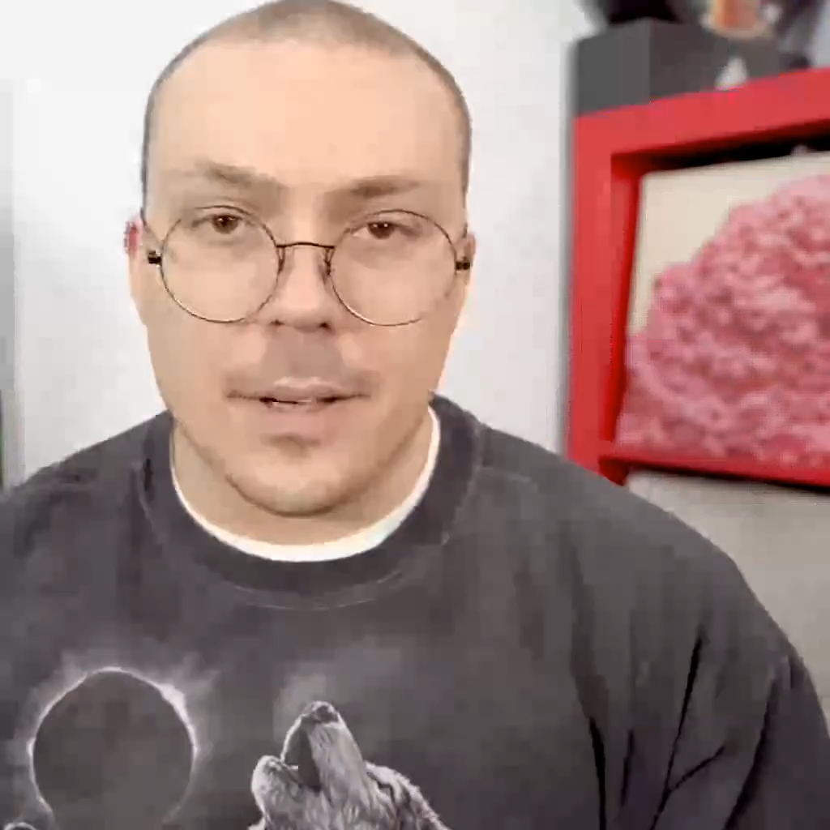
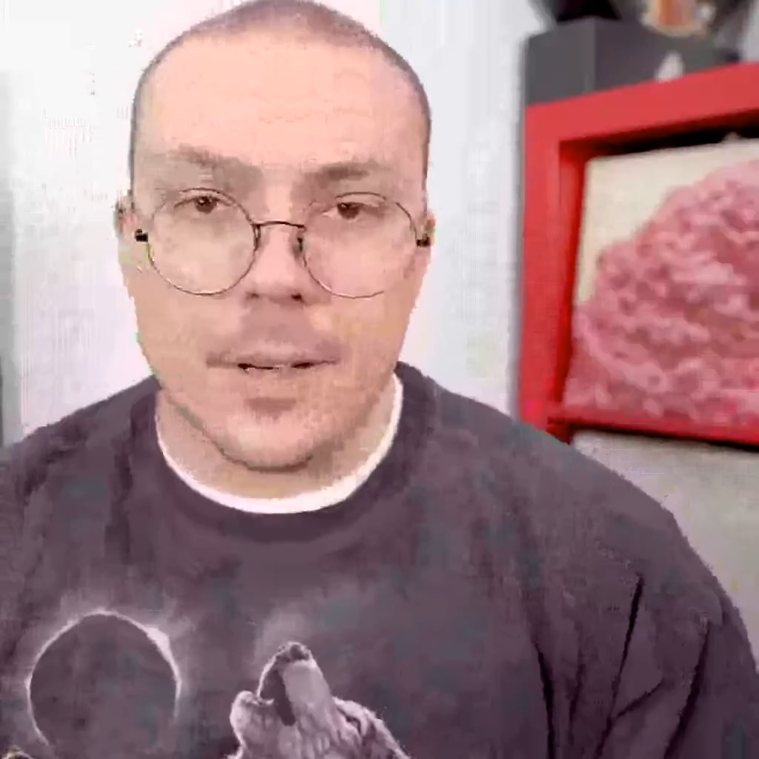
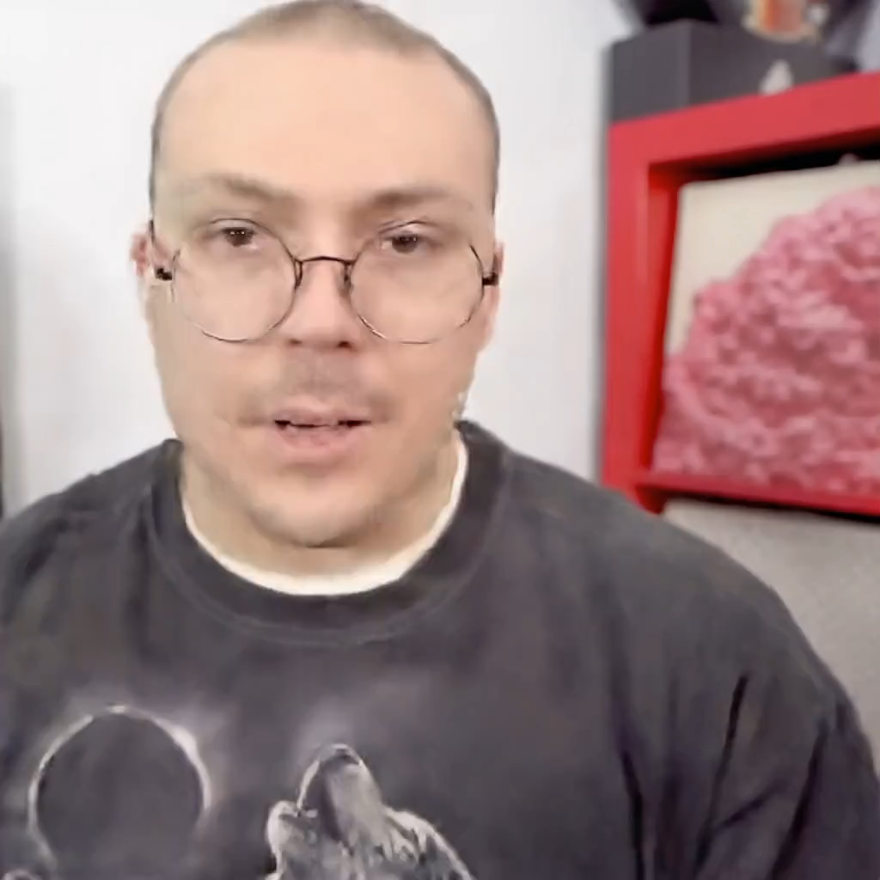
Main Takeaway
Ground Truth
VP8 at 540 Kbps
VP9 at 172 Kbps
Gemino at 75 Kbps
On average, 7-10x reduction in bitrate from VP8 with reasonable quality
2.2x and 5x reduction for same visual quality with VP9 and VP8
Notes:
Look for better example - look at images
gemino 256x256
There have been more recent codecs like vp9 for which we still observe about a 3x reduction for reasonable visual quality

Slide 10
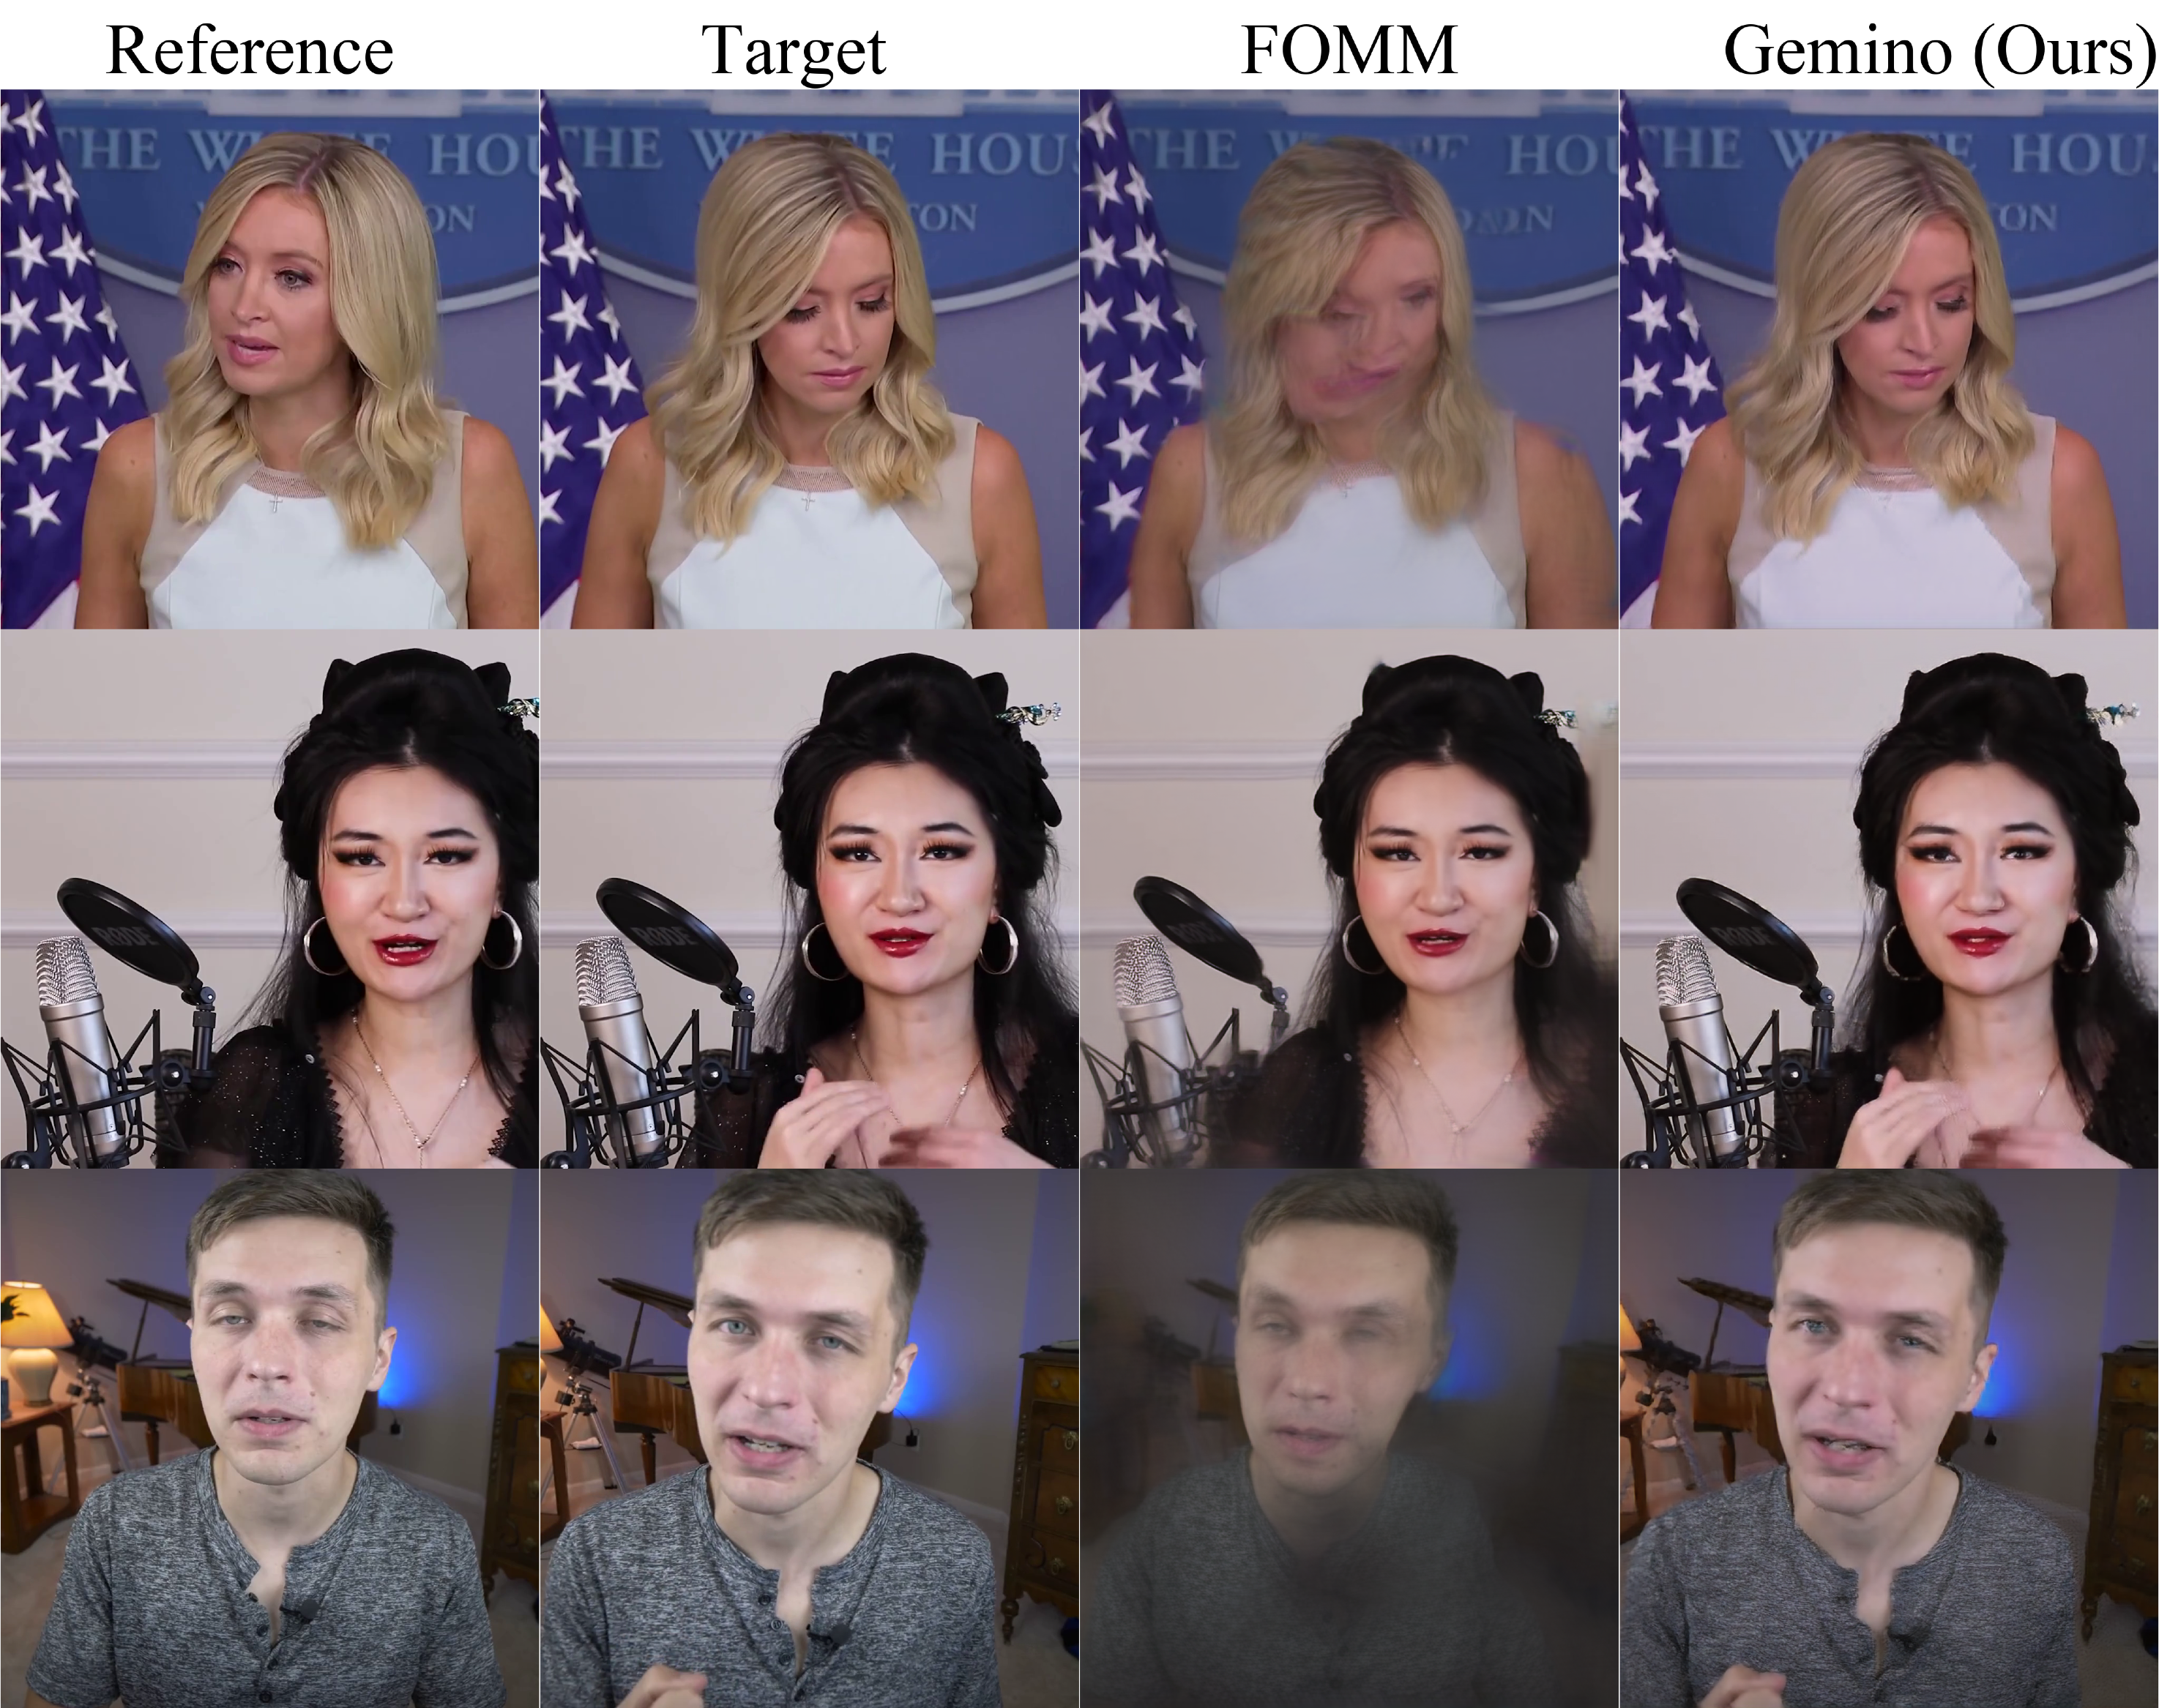
Gemino’s Neural Video Conferencing
128x128 Target
1024x1024 Target
Extreme super-resolution enables video-conferencing at audio bitrates (~30 Kbps)
Notes:
We’ve developed this technology to dramati
In contrast, current approaches can’t really compress below a few 100 kbps in real-time
Add a figure that shows low-res of what size to HD resolution of this size – this is why get this much bandwidth savings

Slide 11

Super Resolution Approaches
High-frequency content is missed
1024x1024 Target
Upsampled 128x128 Target
Can we recover the high-frequency information from a reference frame?
Notes:
One might ask- really what we’re doing is a version of super-resolution. Why don’t we just upsample?
Here’s an example of the same frame – it gets a decent number of the features, but microphone area still glitchy. Specifically, high-frequency content not conveyed efficiently. Hence, our design uses both pathways so that we can both recover high-frequency and low-frequency content with high fidelity.

Slide 12
Gemino Design
Notes:
Hence, our design uses both pathways so that we can both recover high-frequency and low-frequency content with high fidelity.

Slide 13
Gemino Design
Notes:
Hence, our design uses both pathways so that we can both recover high-frequency and low-frequency content with high fidelity.

Slide 14
Gemino Design
Notes:
We measure the motion relative to the reference so we can accordingly adjust or transform the features from the reference to the target.
We also use features directly from the target in the decoding pipeline to help with fidelity.

Slide 15
Gemino Design: High-freq Conditional SR
1
2
Notes:
We measure the motion relative to the reference so we can accordingly adjust or transform the features from the reference to the target.
We also use features directly from the target in the decoding pipeline to help with fidelity.

Slide 16
System Prototype
Notes:
Built atop webrtc
A peer-to-peer connection is set up via a standard signaling mechanism common to most video-conferencing applications
Establishes separate streams for audio and video. Audio is ignored in our setup
All our data is transmitted over RTP atop UDP. Standard for video communication

Slide 17
System Prototype
target bitrate
Notes:
Describe how the different resolutions allow it to trade off bitrate with quality because it can switch to a lower bitrate as it sees fit?

Slide 18
System Optimizations
Improving Model Fidelity:
Codec-in-the-loop Training
Personalization
Reducing Computational Overheads
Multi-scale Architecture
Neural Architecture Search

Slide 19
Evaluation
Custom Dataset: 5 Youtube channels, 15 train videos, 5 test videos each
Pre-processed to crop 1024x1024 front-facing sections
Personalized models for each celebrity and configuration
Trained for 30 epochs with VGG perceptual, pixelwise, feature-matching, and adversarial losses
Compared PSNR, SSIM, LPIPS (learned perceptual quality metric)
Uses NVIDIA A100 system for real-time video reconstruction
Notes:
1024x1024 comparable to 720p
Didn’t use nvidia in talk – but felt it needed to be added

Slide 20
Traditional Codecs vs. Gemino
Notes:
Break this into individual plots

Slide 21
Traditional Codecs vs. Gemino
Notes:
Break this into individual plots

Slide 22
Traditional Codecs vs. Gemino
VP8 and VP9 require 5x and 2.2x of Gemino’s bitrate to provide comparable reconstruction quality respectively
Notes:
Break this into individual plots

Slide 23
Low-bitrate Regime Results
Bicubic atop VP9 requires 2x of Gemino’s bitrate to provide comparable reconstruction quality
Notes:
VP8 and VP9 do not operate in this low bitrate regime, so instead we take the same compressed frame at the desired resolution and target bitrate and supply it to bicubic instead of gemino’s neural upsampling

Slide 24
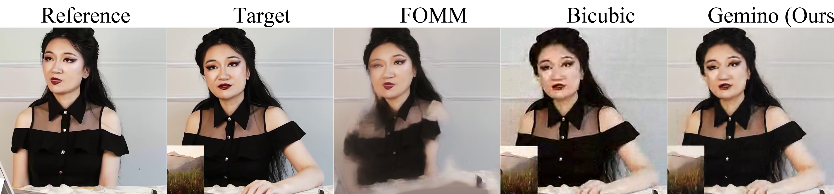
Low-bitrate Regime Results
Target
Bicubic
Gemino
Notes:
Another slide about comparing it to just super-resolution and content adapted: add super resolution cdf comparison and a visual slide – there is benefit from having the high-frequency reference frame because we’re not finetuning per-person

Slide 25
Gemino Design: High-freq Conditional SR
1
2
Notes:
Now, we’ll compare Gemino to other learned approaches. Recall that Gemino uses two pathways – one the super resolution pathway, and one with warped high-resolution features from the reference frame. Here, we’ll compare it to other learned approaches that use one of these two pathways but not both to drive home the need for both.

Slide 26
Warping with Reference vs. Gemino
Notes:
First, we look at other approaches that use a high-resolution reference and warp its features but without low-resolution target. Instead, the FOMM transmits keypoints or sparse facial landmarks to convey the target pose. Turns out this performance is quite worse, because these keypoints are very limited in what they can convey.

Slide 27
Warping with Reference vs. Gemino
Reference
Target
FOMM Prediction
Gemino
Large motion
Notes:
Specifically, if there’s large motion between the reference and target, the FOMM produces a blob because it cannot accurately capture the motion between them .
Secondly, if there are new parts in the target frame, an approach that simply relies on the reference – will entirely miss it. For example, this palm is entirely missed because there’s no notion of what the features associated with it look like without the target frame.

Slide 28
Warping with Reference vs. Gemino
Reference
Target
FOMM Prediction
Gemino
Large motion
New parts in target frame
Notes:
Secondly, if there are new parts in the target frame, an approach that simply relies on the reference – will entirely miss it. For example, this palm is entirely missed because there’s no notion of what the features associated with it look like without the target frame. Gemino is able to use features from the low-resolution frame to do this better.

Slide 29
Content-Adapted SR vs. Gemino
Notes:
The other class of learned approaches uses just the super-resolution pathway without the reference. We call this pure upsampling, and in this cdf of lpips or perceptual quality of frames and videos, gemino outperforms upsampling in the entire regime.

Slide 30
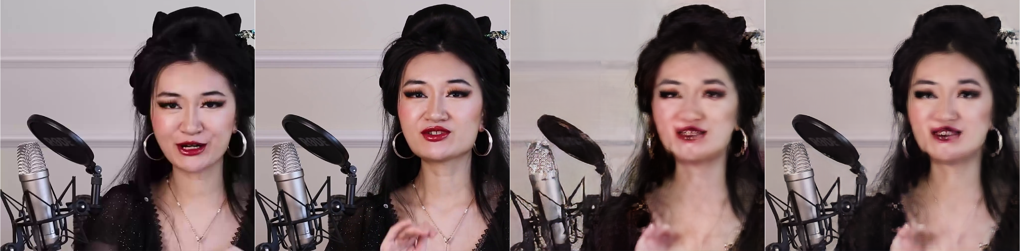
Content-Adapted SR vs. Gemino
Reference
Target
Pure Upsampling
Gemino
Notes:
Specifically, this difference manifests as better reconstruction of the high-frequency content.
128x128 at 15 Kbps

Slide 31
Model Speed
GPU | FOMM | Gemino (Opt.)
TitanX | 187.30 ms | 26.81 ms
NVIDIA V100 | 117.27 ms | 17.42 ms
NVIDIA A100 | 32.96 ms | 13.89 ms
Real-time deadline: 33ms for 30 fps
Notes:
FOMM is a reference here because our architecture was motivated by this, but with all the optimizations mentioned, we were able to get it to real-time on titanx

Slide 32
Bitrate Adaptation
1024x1024 resolution
30 frames per second
Lower is Better
Notes:
Break this up – see what’s going on with the visual quality

Slide 33
Bitrate Adaptation
1024x1024 resolution
30 frames per second
Lower is Better
Notes:
Break this up – see what’s going on with the visual quality

Slide 34
Bitrate Adaptation
1024x1024 resolution
30 frames per second
Lower is Better
Notes:
Break this up – see what’s going on with the visual quality

Slide 35
Gemino Summary
Gemino uses high-frequency conditional super-resolution to dramatically reduce video conferencing bandwidth requirements to few 10s of Kbps
2.2x reduction in bitrate for same visual quality with VP9
Gemino runs in real-time at 1024x1024 on a TitanX GPU
Contact: vibhaa@mit.edu

Slide 37
Model Architecture
Notes:
Produces a combined set of features that are decoded back to full-resolution using a matching set of decoder upsampling layers at the receiver.

Slide 38
Keypoint Detector
Notes:
Produces a combined set of features that are decoded back to full-resolution using a matching set of decoder upsampling layers at the receiver.

Slide 39
Motion Estimator
Notes:
Produces a combined set of features that are decoded back to full-resolution using a matching set of decoder upsampling layers at the receiver.

Slide 40
Generator Architecture
Notes:
Produces a combined set of features that are decoded back to full-resolution using a matching set of decoder upsampling layers at the receiver.

Slide 41

Further Optimizations
Depthwise-separable convolutions in place of standard convolutions
NetAdapt to iteratively prune layers of the model
Choose # of channels to prune for budget
Choose which channels to prune
Short-term Finetune
Layer 1
Iteration i
Pick highest accuracy option
Current Pruned
Model
Choose # of channels to prune for budget
Choose which channels to prune
Short-term Finetune
Layer k
NetAdapt: Platform-Aware Neural Network Adaptation for Mobile Applications, Yang et al., ECCV 2018
Notes:
A lot of other thought also went into this with regards to thinking about what resolution to operate different parts of the model. For instance, the generative part of the pipeline such as the encoder for the reference frame needs the entire high-resolution reference to reconstruct high-frequency detail. So, we supply that in high resolution but add additional downsampling layers to maintain a reasonable spatial dimension.

Slide 42

Further Optimizations
Depthwise-separable convolutions in place of standard convolutions
NetAdapt to iteratively prune layers of the model
Iteration 1
Iteration 2
Iteration k
Long-term Finetune
Original Model
NetAdapt: Platform-Aware Neural Network Adaptation for Mobile Applications, Yang et al., ECCV 2018
Notes:
A lot of other thought also went into this with regards to thinking about what resolution to operate different parts of the model. For instance, the generative part of the pipeline such as the encoder for the reference frame needs the entire high-resolution reference to reconstruct high-frequency detail. So, we supply that in high resolution but add additional downsampling layers to maintain a reasonable spatial dimension.

Slide 43
Compute Optimizations
Convolution Type | Regular |  |  | Depthwise
NetAdapt Target | None | 10% | 1.5% | None | 10% | 1.5%
Decoder MACs | 195B | 14.7B | 2.4B | 22.7B | 1.7B | 0.3B
Decoder Parameters | 30M | 1.3M | 151K | 3.4M | 186K | 26K
Titan X Inference | 46ms | 17ms | 12ms | 53ms | 26ms | 13ms
Jetson TX2 Inference | 800ms | 274ms | 165ms | 436ms | 183ms | 87ms
LPIPS (Generic) | 0.13 | 0.15 | 0.17 | 0.14 | 0.16 | 0.19
LPIPS (Personalized) | 0.13 | 0.13 | 0.15 | 0.14 | 0.14 | 0.17

Slide 44
Achieving the Rate-Distortion Curve
Flexible input resolution and codec based on target bitrate
Bitrate Regime | Resolution | Codec
< 30 Kbps | 128x128 | VP8
30 Kbps – 75 Kbps | 256x256 | VP8
75 Kbps – 200 Kbps | 512x512 | VP9
> 200 Kbps | 1024x1024 | VP9
Notes:
First, we leverage the benefits of modern codecs in the design of our scheme, and design our model with the flexibility to operate on any input resolution based on the target bitrate regime. For instance, based on current codec capabilities to compress video to under 30 Kbps, we’d have to use 128x128 for the target frame’s resolution. As the target bitrate increase, we are able to increase the resolution.
However, to accommodate this, our model needs to be retrained for different starting resolutions, so we first profile the codecs, identify what resolutions it can compress for each bitrate range and then train a model for that regime. Here’s an example.

Slide 45
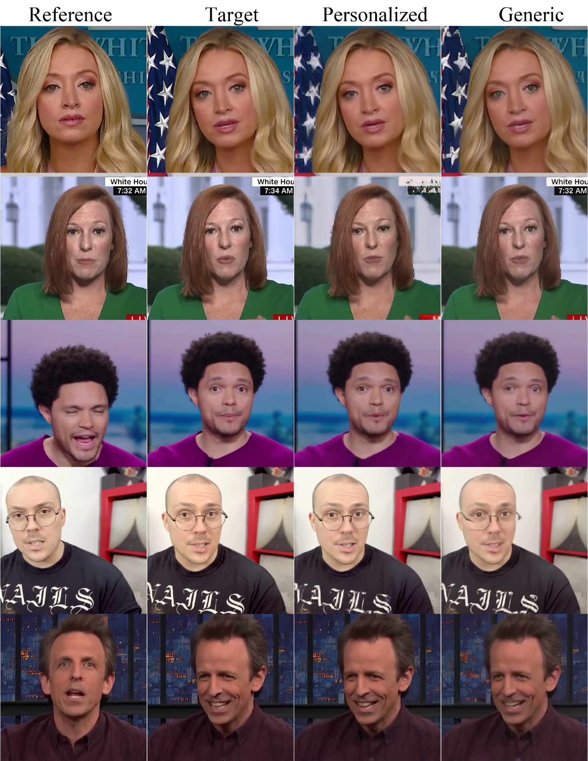
Personalized models
Fine-tuning models on a per-person basis for improved fidelity
Target
Personalized
Generic
Notes:
To improve fidelity, we finetune our model to each person so that it can understand the high-frequenct content for that person.
Here’s an example comparing generic reconstruction to personalized and you notice the reconstruction of the glasses, and the eyes are better with the personalized model.
We envision caching these models for each person that we regularly converse with on the receiver side.
use one per slide and make it bigger

Slide 46
Personalized models
Fine-tuning models on a per-person basis for improved fidelity
Target
Personalized
Generic
Notes:
To improve fidelity, we finetune our model to each person so that it can understand the high-frequenct content for that person.
Here’s an example comparing generic reconstruction to personalized and you notice the reconstruction of the glasses, and the eyes are better with the personalized model.
We envision caching these models for each person that we regularly converse with on the receiver side.
use one per slide and make it bigger

Slide 47
Efficient Inference
Most models are designed for 256x256 resolutions
Naively re-using the same model for larger resolution results in large compute costs
 | First-Order Motion Model
GPU | 256x256 | 512x512 | 1024x1024
TitanX | 17.35 ms | 50.13 ms | 187.30 ms
NVIDIA V100 | 12.48 ms | 33.11 ms | 117.27 ms
NVIDIA A100 | 8.19 ms | 12.76 ms | 32.96 ms
As the input resolution increases, operations per pixel must decrease
Real-time deadline:
33 ms for 30 fps
Notes:
A lot of other thought also went into this with regards to thinking about what resolution to operate different parts of the model. For instance, the generative part of the pipeline such as the encoder for the reference frame needs the entire high-resolution reference to reconstruct high-frequency detail. So, we supply that in high resolution but add additional downsampling layers to maintain a reasonable spatial dimension.

Slide 48
Multi-scale Architecture
Motion is estimated at low-resolution
Notes:
Hence, our design uses both pathways so that we can both recover high-frequency and low-frequency content with high fidelity.
As resolution increases, operations per pixel must decrease
Carefully choose the resolution of different modules

Slide 49
Multi-scale Architecture
Generator operates at full resolution
Notes:
Hence, our design uses both pathways so that we can both recover high-frequency and low-frequency content with high fidelity.

Slide 50
Computational Overheads
Depthwise-separable convolutions in place of standard convolutions
NetAdapt to iteratively prune layers of the model
 | First-Order Motion Model |  |  | Gemino | Gemino (Opt.)
GPU | 256x256 | 512x512 | 1024x1024 | 1024x1024 | 1024x1024
TitanX | 17.35 ms | 50.13 ms | 187.30 ms | 68.08 ms | 26.81 ms
NVIDIA V100 | 12.48 ms | 33.11 ms | 117.27 ms | 41.23 ms | 17.42 ms
NVIDIA A100 | 8.19 ms | 12.76 ms | 32.96 ms | 17.66 ms | 13.89 ms
NetAdapt: Platform-Aware Neural Network Adaptation for Mobile Applications, Yang et al., ECCV 2018
Notes:
A lot of other thought also went into this with regards to thinking about what resolution to operate different parts of the model. For instance, the generative part of the pipeline such as the encoder for the reference frame needs the entire high-resolution reference to reconstruct high-frequency detail. So, we supply that in high resolution but add additional downsampling layers to maintain a reasonable spatial dimension.

